Slide 1
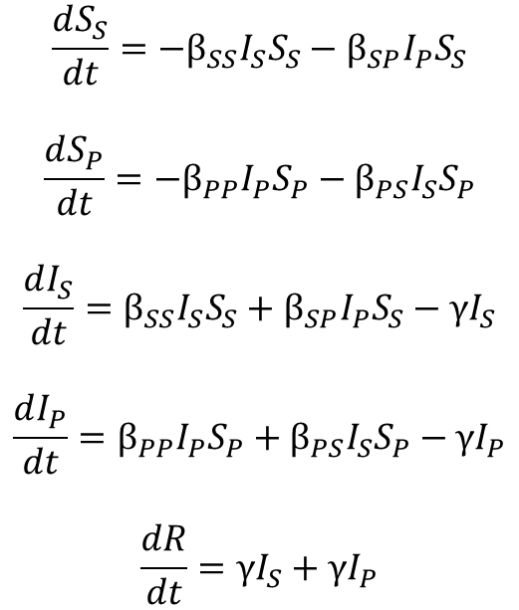
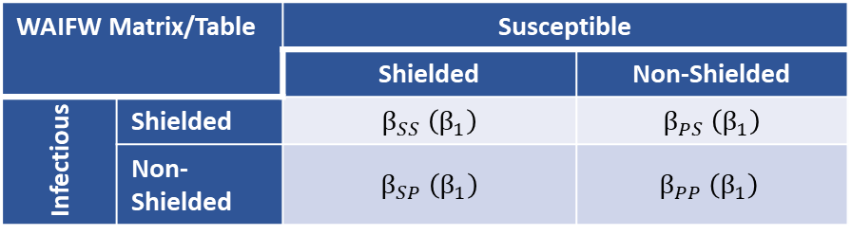

“Shielded”
Population
S_{S}
β_{SS}I_{S}S_{S}
I_{S}
Model Equations
γI_{S}
β_{SP}I_{P}S_{S}
$$\frac{dS_{S}}{dt}=−β_{SS}I_{S}S_{S}−β_{SP}I_{P}S_{S}$$
$$\frac{dS_{P}}{dt}=−β_{PP}I_{P}S_{P}−β_{PS}I_{S}S_{P}$$
$$\frac{dI_{S}}{dt}=β_{SS}I_{S}S_{S}+β_{SP}I_{P}S_{S}−γI_{S}$$
$$\frac{dI_{P}}{dt}=β_{PP}I_{P}S_{P}+β_{PS}I_{S}S_{P}−γI_{P}$$
$$\frac{dR}{dt}=γI_{S}+γI_{P}$$
β_{PS}I_{S}S_{P}
R
“non-Shielded”
Population
S_{P}
I_{P}
γI_{P}
β_{PP}I_{P}S_{P}
WAIFW Matrix/Table |  | Susceptible
 |  | Shielded | Non-Shielded
Infectious | Shielded | $β_{SS}$ $\left(β_{1}\right)$ | $β_{PS}$ $\left(β_{1}\right)$
 | Non-Shielded | $β_{SP}$ $\left(β_{1}\right)$ | $$β_{PP} \left(β_{1}\right)$$
Baseline
Where the 2nd subscript indicates the “infectious” population and the 1st subscript indicates the “susceptible” population.
WAIFW Matrix/Table |  | Susceptible
 |  | Shielded | Non-Shielded
Infectious | Shielded | $β_{SS}$ $\left(β_{1}\right)$ | $β_{PS}$ $\left(β_{2}\right)$
 | Non-Shielded | $β_{SP}$ $\left(β_{1}\right)$ | $$β_{PP} \left(β_{2}\right)$$
During the
Intervention (24 Weeks)
β1 < β2

